Slide 1

The Future of Java + You 25 Years of Progress in the Making
Knoxville Java User Group
2021-02-23
Sharat Chander
Senior Director, Java Product Management & Developer Engagement
Java Platform Group
Oracle, Corp.
@Sharat_Chander

Slide 2

https://www.oracle.com/java/moved-by-java
https://www.oracle.com/java/moved-by-java/timeline
Notes:
[GEORGES]:
As Sharat mentioned, 2020 is a memorable year for Java as we celebrate its 25th birthday.
Right from the start, Java grew swiftly in popularity, and expanded its reach to many different areas of software development.
Today, Java continues to evolve with important language features building on the momentum of earlier steps forward such as Generics in Java 5, Lambdas in Java 8 and Modules in Java 9…but with a constant underlying focus on improving performance, stability and security of the platform along the way.
[CHAD]:
I’ll add one to this slide… I took the Fortune 100 list, a list of the 100 largest companies based in the US, and visited every single public job board. I found that 98 of them are hiring Java developers. How is that for job security, by choosing to continue to work with the world’s #1 programming language.
[CLICK TO NEXT SLIDE]

Slide 3

Flexibility to adapt to the changing technology landscape while remaining platform independent
Reliability and the ability to retain the value of its original IT investments
Performability to accelerate innovation without sacrificing security
#1
Programming Language
69%
Developers run Java
51B
Active JVMs
30B
Active cloud JVMs
#1
Developer choice in the cloud
Notes:
As you know, 2020 is a memorable year for Java as we celebrate its 25th birthday.
Over the 25 years, Java has given all of us over two decades of Innovation
Java continues to evolve with important language features built on the momentum of previous enhancements such as Generics in Java 5, Lambdas in Java 8 and Modules in Java 9…culminating in its ability to boost performance, stability and security of the platform along the way.
Java’s ability to continue to be the #1 programming language of choice in a sea of other options.
Java persists by offering unparalleled uniqueness to stay relevant in the modern application development landscape.
While at the same time, we ensure that any Java innovation we introduce allows for backwards compatibility.
We want users to be able to maximize previous Java technology investments they’ve made at every as they adapt to a sea of rapid technology changes.

Slide 4
Relentless pursuit of
developer productivity and application performance
programming paradigms
application styles
deployment models
hardware
in the face of
constant evolving…
Notes:
and this doesn't happen by accident...

Slide 5

Thoughtful Approach to Language Evolution
Less Change
More Change
Conservatism
Better safe than sorry
Compatibility
Don’t alienate users
Innovation
Adapting to change
Fixing mistakes
Notes:
There are two forces at play, the forces that want change, developer fashion, hardware changes, to fix past mistakes, to move quicker and innovate
And forces of compatibility, ensure programs keep running without breakage. Very low tolerance to incompatibility. Fashion of the week can leave things worse than better.
The folks at the wheel are hated by both sides.
“Two kinds of programming languages, the ones people complain about, and the ones nobody uses.”

Slide 6
25 reasons the future of Java is Bright

Slide 7

1
Preserving Java’s Virtues
Ease of Use Language fundamentals based on improving C++ to provide powerful, simple to use language.
Security Java’s architecture, originally designed for embedded devices, was designed with security in mind.
Reliability Java is strongly typed with heavily tested libraries and extensive tooling making Java robust.
Platform Independence Carrying forward the “Write once, run anywhere”; agnostic of operating system and hardware.
7
Notes:
And how will we ensure Java continues to offer value over the next 25 years and beyond?
By staying true to the virtues that’s made Java successful for so long.
As we strategize on technical improvements and build new features, we lean in and embrace what has given Java value the last 25 years.

Slide 8

Foster Open Innovation
2
“The place to collaborate on an open-source implementation of Java SE, and related projects.”
https://openjdk.java.net/
8

Slide 9
Open Development
3
“Mailing lists on mail.openjdk.java.net that you can subscribe to and follow the conversations around development progress.”
https://mail.openjdk.java.net/mailman/listinfo
9

Slide 10
4
OpenJDK Developers Guide
“A living/breathing guide answering questions that developers of the JDK might have around the development process, tooling, standards, and more.”
https://openjdk.java.net/guide
10

Slide 11
5
Ecosystem Participation
Author
Contributor who submits patches through a sponsor
Committer
Author with push access to the project’s code repository
Reviewer
Experienced committer who has the authority to approve changesets
Project Lead
Committer who is responsible for directing and coordinating the project’s activities
https://openjdk.java.net/contribute
11

Slide 12
6
Offering Choice
Oracle OpenJDK
Open-Source Release
Oracle OpenJDK
Commercial Release
https://jdk.java.net
https://oracle.com/javadownload
12

Slide 13
7
Tools, Tools, Tools!
jdeps (Java 8)
(Java Class Dependency Analyzer)
Shows the package-level or class-level dependencies of Java class files.
jdeprscan (Java 9)
(Java Deprecation Scanner)
Scans a jar file for uses of deprecated API elements.
jlink (Java 9)
(Java Linker)
Create a custom JRE for your application, which assembles and optimizes the Java modules and their dependencies needed to run your application.
Java Doc (Java 9)
Adds a search box to API documentation generated by the standard doclet that can be used to search for program elements and tagged words and phrases within the documentation.
https://openjdk.java.net/tools
13

Slide 14
8
Gathering Feedback
Experimental
Features
A test-bed mechanism used to gather feedback on nontrivial HotSpot enhancements.
Incubator
Modules
Enables the inclusion of JDK APIs and JDK tools that might one day, after improvements and stabilizations, be included and supported in the Java SE platform or in the JDK.
Preview
Features
A feature that is believed to be fully specified and implemented, but may still change before it is included in the Java platform on a final and permanent basis. The gathered feedback will be evaluated and used to make eventual adjustments before a feature becomes permanent.
https://blogs.oracle.com/javamagazine/the-role-of-previews-in-java-14-java-15-java-16-and-beyond
14

Slide 15
9
Innovating for the Future
Panama
Improving and enriching the connections between the Java virtual machine and well-defined but “foreign” (non-Java) APIs
Valhalla
Higher density and performance of machine learning and big data applications through the introduction of inline classes
Loom
Massively scale lightweight virtual threads, making concurrency simple again
Amber
Continuously improve developer productivity through evolutions of the Java language
Leyden
Address long-term pain points of Java’s start-up time, time to peak performance and large footprint
ZGC
Create a scalable low latency garbage collector capable of handling large heaps
https://openjdk.java.net
15

Slide 16
10
Predictable Release Schedule
90+
JEPs
50+
New Release Cadence
12
17
16
14
8
5
Mar 2014
Sept 2017
Mar 2018
Sept 2018
Mar 2019
Sept 2019
Mar 2020
Sept 2020
3 +
Years
6
Months
6
Months
6
Months
6
Months
6
Months
6
Months
16

Slide 17
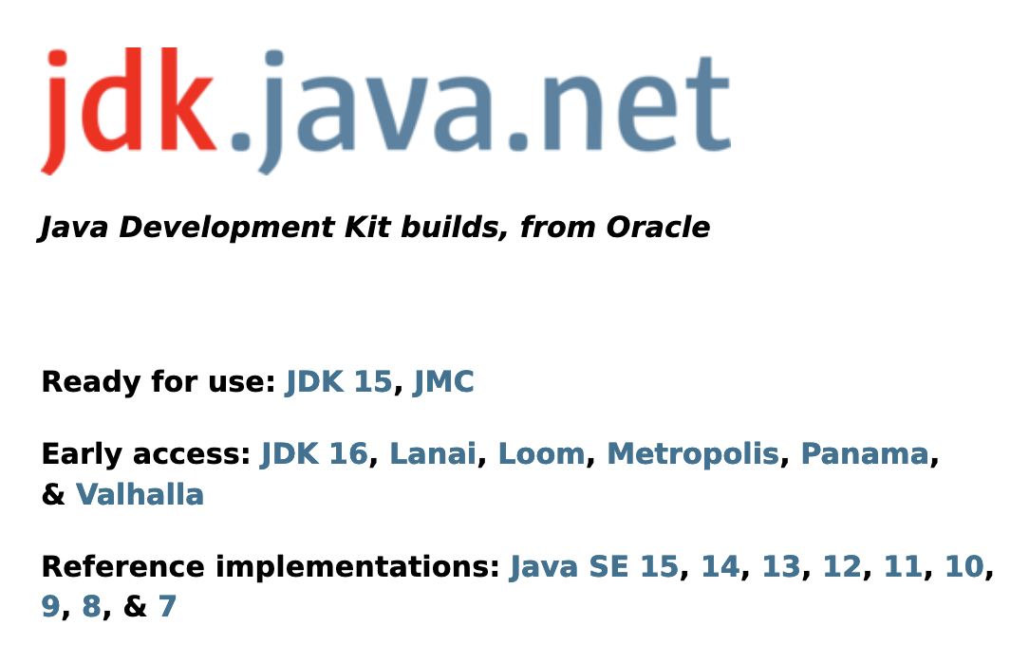
11
Early Access
https://jdk.java.net
17

Slide 18
12
Modern HW Certified Configurations
Windows Server 2019, 2016, 2012 R2, 2012
Windows 10, 8
Oracle Linux and Red Hat Enterprise Linux (x64) 8, 7, 6
Oracle Linux 7.6 on ARM 64
SuSe Linux Enterprise Server 15, 12
Ubuntu Linux 20.04 LTS 19.10, 18.04 LTS
macOS 10.13, 10.14, 10.15
Virtualization: Oracle VM, Docker, Microsoft Hyper-V
64-bit only on all platforms
18
* Reflects certified configurations for JDK 15

Slide 19
13
Libraries! Libraries! Libraries!
Frameworks! Frameworks! Frameworks!
Akka
Ant
Avatica
Bean Validation
Blynk Server
BootstrapFX
Byte Buddy
Calcite
CalendarFX
Camel
cglib
Commons Lang
CruiseControl
DataMelt
Derby
DesktopPaneFX
Eclipse Collections
Eclipse EclEmma
e(fx)clipse
Elasticsearch
EqualVerifier
FlexGanttFX
Flyway
FormsFX
FunctionalJava
FXyz
Gluon Maps
Gluon Mobile
Gradle
GraphHopper
HdrHistogram
HeapStats
Hibernate ORM
Hibernate Validator
Ikonli
Install4j
Instana
Jackson
JaCoCo
JavaCPP
JavaCV
Javalin
JavaSpec
Javassist
JCTools
Jersey
Jetty
JITWatch
Joda Beans
Joda Convert
jOOQ
JOSM
JProfiler
JRebel
JSillouette
Junit
JUnit
Kafka
Lettuce
Lilith
Log4J
Logback
Lucene
LWJGL
Maven
Micronaut
Mokito
Netty
OpenJFX
Picoli
PreferencesFX
RabbitMQ
Rapidoid
RTextDoc
RxJava
Selenium
Slf4j
Solr
Spotbugs
Spring Boot
Spring Framework
Stagemonitor
Stanford CoreNLP
Synthetica
TestNG
Thymeleaf
Tika
TweetwallFX
Wicket
Wildfly
Woodstox
WorkbenchFX
Yasson
19

Slide 20
14
Modern Java Infrastructure
“Make all contributors more productive, both new and existing ones.”
Project Skara Mission Statement
JEP 357: Migrate from Mercurial to Git (Java 16)
JEP 369: Migrate to GitHub (Java 16)
The project has developed various tooling to assist with this effort:
Server-side tooling compatible with GitHub and GitLab
Client-side tooling compatible with Git and Mercurial
September 5, 2020 transition completed of JDK 16 mainline to GitHub
https://github.com/openjdk
20

Slide 21
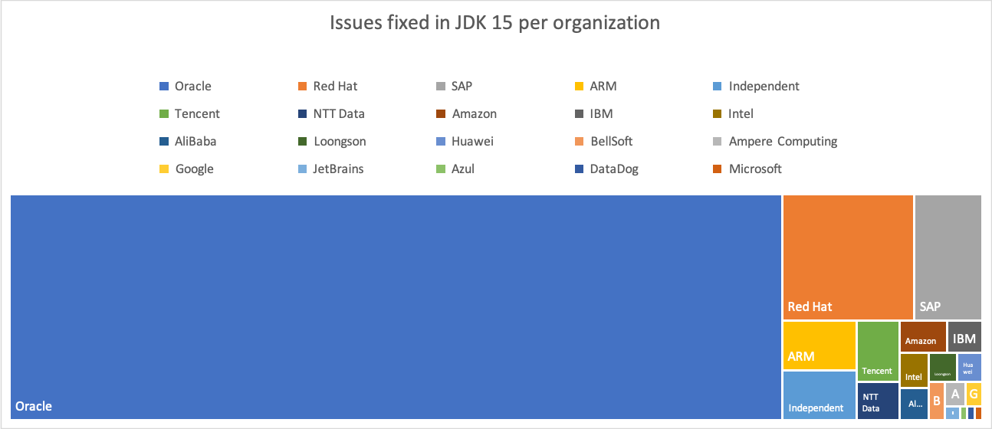
15
Industry Participation
https://blogs.oracle.com/java-platform-group/the-arrival-of-java-15
21

Slide 22
16
Individual Participation
Uwe Schindler (representing Apache Lucene)
Xeno Amess (representing Apache Maven)
Tilman Hausherr (representing Apache PDFBox)
Mark Thomas (representing Apache Tomcat)
Raphael Winterhalter (representing Byte Buddy)
Simone Bordet (representing Eclipse Jetty)
Peter Karich (representing Graphhopper)
Marc Hoffmann (representing JaCoCo)
Vincent Privat (representing JOSM)
Christian Stein (representing JUnit)
Norman Maurer (representing Netty)
https://blogs.oracle.com/java-platform-group/the-arrival-of-java-15
22
* Reflects contributions to JDK 15

Slide 23
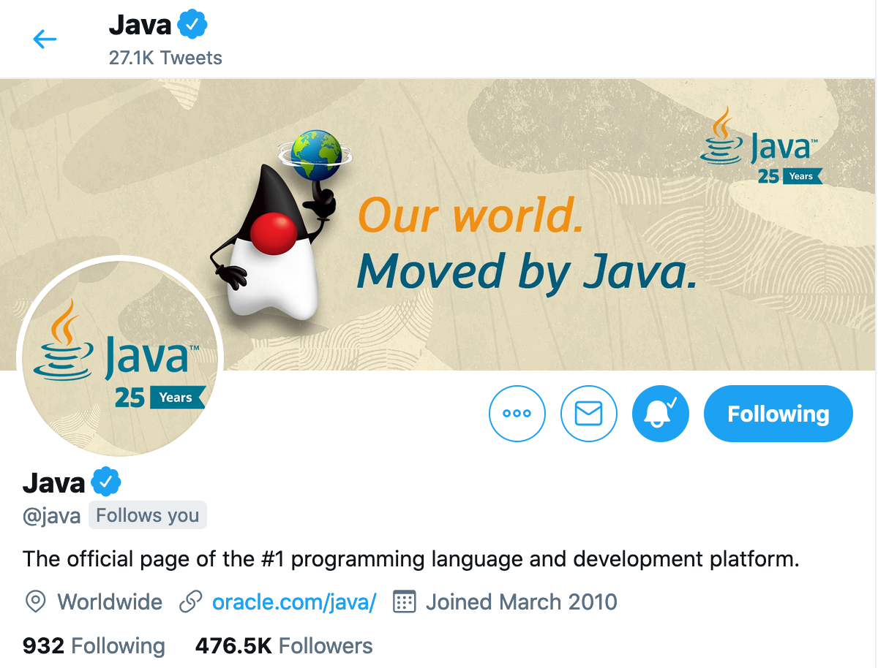
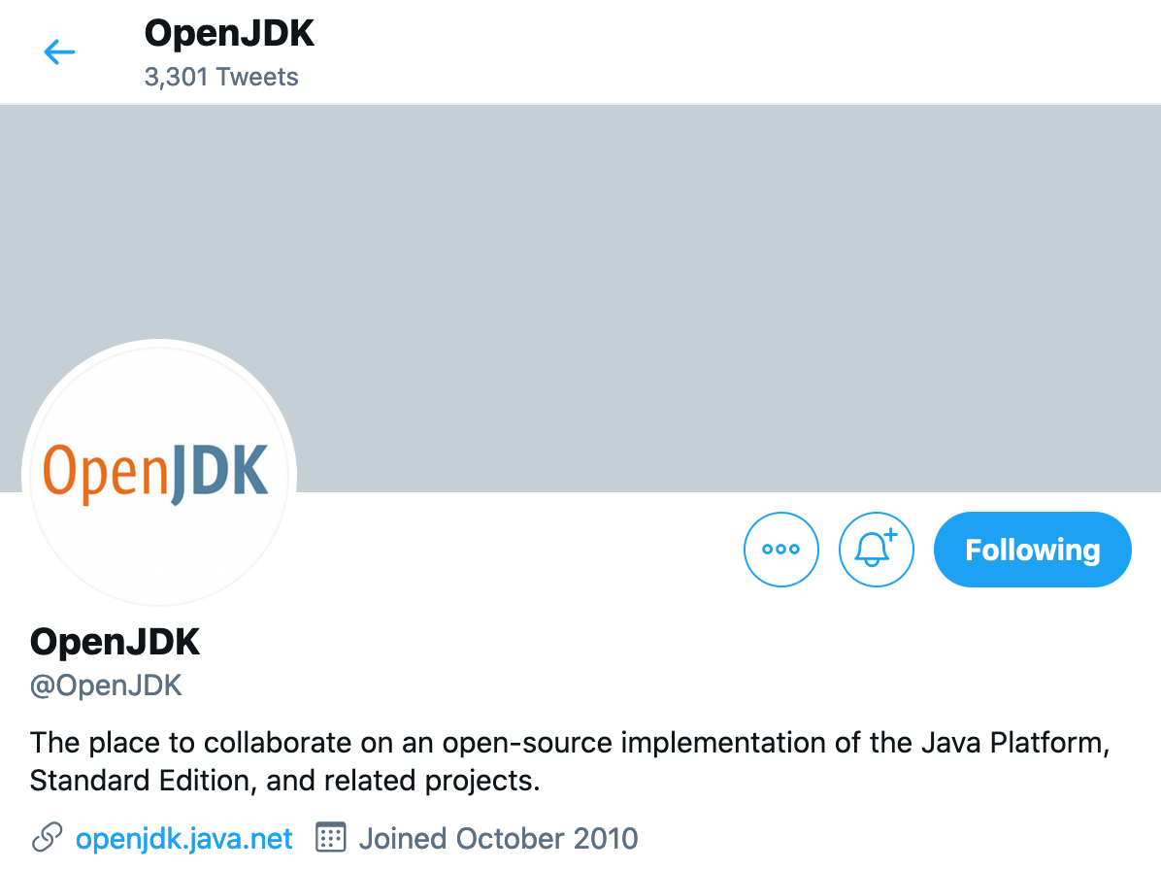
17
Social Connection
https://twitter.com/java
https://twitter.com/openjdk
23

Slide 24
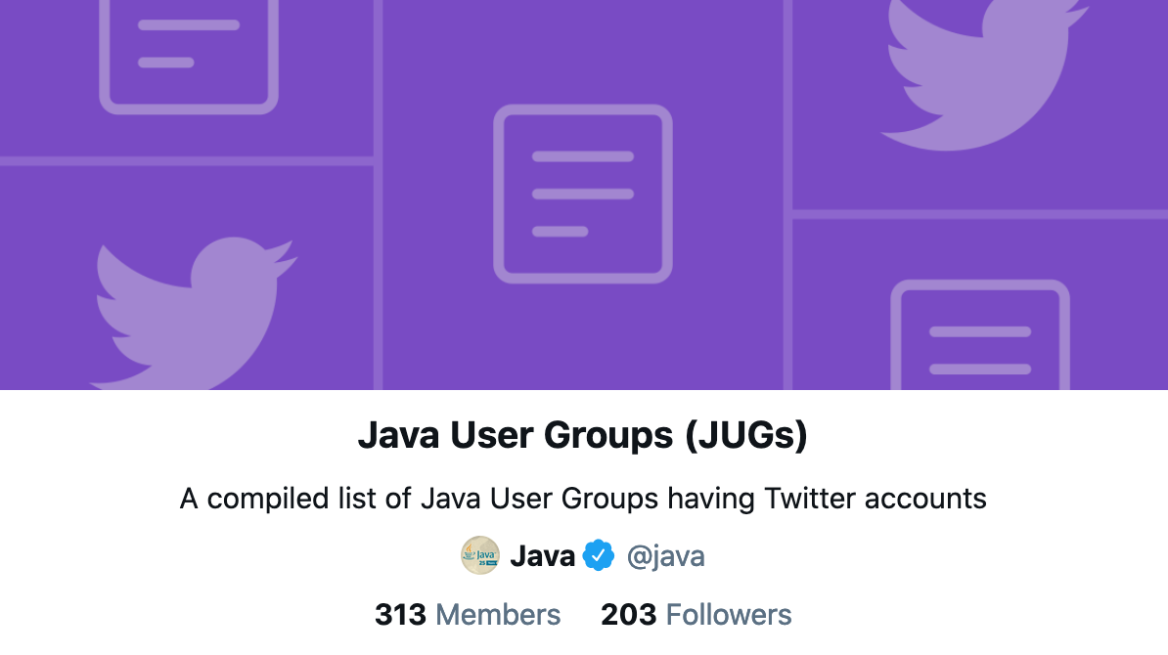
18
Java User Groups
https://twitter.com/i/lists/221697230
24

Slide 25

19
Up-to-Date, Current Information on Java Innovation
https://inside.java/
25

Slide 26

20
Hear from the Voices Inside the Java Team
“Interview discussions on the language, the JVM, OpenJDK, platform security, innovation projects like Loom and Panama, and everything in between!”
https://inside.java/podcast
26

Slide 27
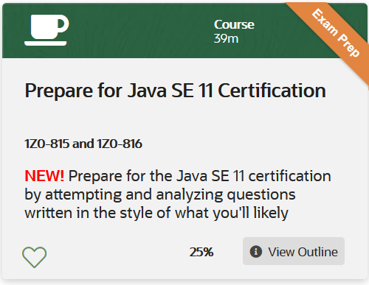

21
Oracle Explorer Program
https://learn.oracle.com/ols/learning-path/java-explorer/40805/79726
27

Slide 28
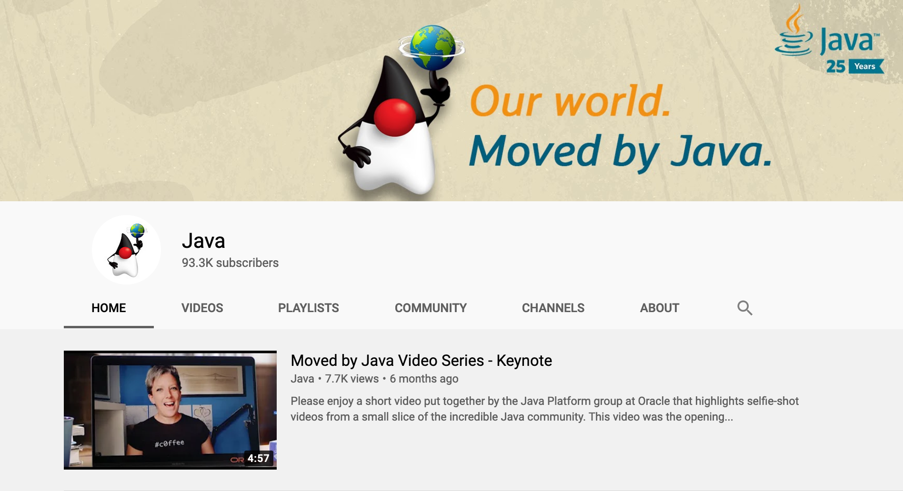
22
Java YouTube
https://www.youtube.com/c/javaplatform
28

Slide 29
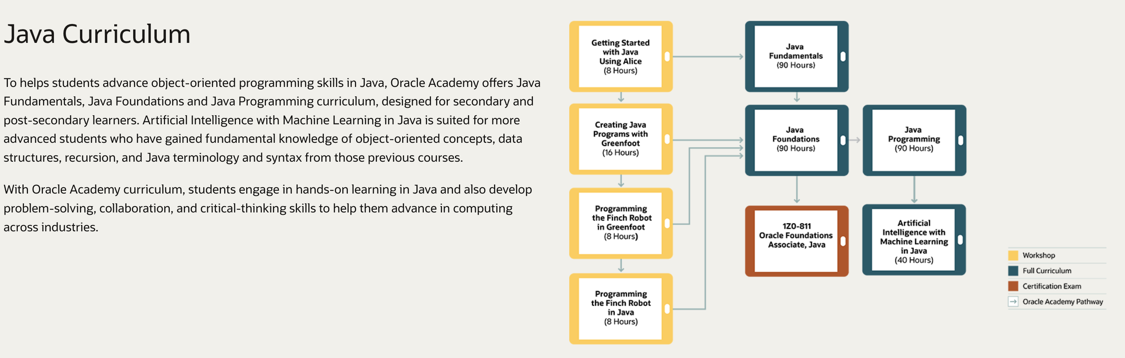
23
Oracle Academy
https://academy.oracle.com/en/solutions-curriculum.html
29

Slide 30

24
Java Newsletter
https://go.oracle.com/LP=29630?elqCampaignId=124071
30

Slide 31

Java + You
25
31

Slide 32

Thriving
Ecosystem
Accelerating
Innovation
Oracle
Stewardship
32

Slide 33

Thank You
#MovedbyJava
openjdk.java.net
inside.java

